Slide 1
Discrete Mathematics BCSC0010
Module 1
Sets(Lecture2)

Slide 2
Cardinality of a set
The cardinality of a set is a measure of a set's size, i.e. the number of elements in the set.
If S is a set with n elements, where n is a nonnegative integer, then n is the cardinality of S. It is denoted by |S|. Thus, |S|=n

Slide 3
Cardinality of a set (Examples)
The set A = { 1 , 2 , 4 } has a cardinality of 3
Let A be the set of odd positive integers less than 10 Then IAI = 5
Let S be the set of letters in the English alphabets Then lSI = 26

Slide 4
Cartesian Product
Let A and B be sets
The Cartesian product of A and B is the set of all ordered pairs (a, b), where a ϵ A and b ϵ B
It is denoted by A x B
Hence, A x B = {(a, b) | a ϵ A and b ϵ B}

Slide 5
Cartesian Product (Examples)
Example − If we take two sets A={a, b} and B={1, 2},
The Cartesian product of A and B is written as A×B={(a,1),(a,2),(b,1),(b,2)}
The Cartesian product of B and A is written as B×A={(1,a),(1,b),(2,a),(2,b)}
Note: A × B is not the same as B × A.
The cardinality of A × B is N*M, where N is the cardinality of A and M is the cardinality of B.

Slide 6
What is the Cartesian product A x B x C where A = {0, 1}, B = {1, 2}, and C = {0, 1, 2}?
Solution
The Cartesian product A x B x C consists of all ordered triples (a, b, c), where a ϵ A, b ϵ B, and c ϵ C. Hence,
A x B x C = {(0, 1,0), (0, 1, 1), (0, 1,2), (0,2,0), (0, 2, 1), (0, 2, 2), (1, 1,0), (1, 1, 1), (1, 1,2), (1, 2, 0), (1, 2, 1),
(1, 2, 2)}

Slide 7
Graphical representation of Sets
Sets can be represented graphically using Venn diagrams.
Named after the English mathematician John Venn, who introduced their use in 1881.
In Venn diagrams the universal set U, which contains all the objects under consideration, is represented by a rectangle.

Slide 8
Graphical representation of Sets
Inside this rectangle, circles or other geometrical figures are used to represent sets.
Sometimes points are used to represent the particular elements of the set.
Venn diagrams are often used to indicate the relationships between sets.

Slide 9
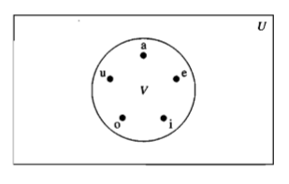
Venn diagram
Venn diagram that represents V, the set of vowels in the English alphabet.

Slide 10
Set Operations
Union
Intersection
Set Difference
Complement

Slide 11
Union of Sets
Let A and B be sets
The union of the sets A and B is the set that contains those elements that are either in A or in B, or in both
It is denoted by A U B
AUB = {x | x ∈ A or x ∈ B}

Slide 12
Union of Sets (Examples)
if A = {1, 3, 5, 7} and B = {1, 2, 4, 6, 7}
Then A ∪ B = {1, 2, 3, 4, 5, 6, 7}
The union of the sets {I, 3, 5} and {I, 2, 3}
{I, 3, 5} U {I, 2, 3} = {I, 2, 3, 5}

Slide 13
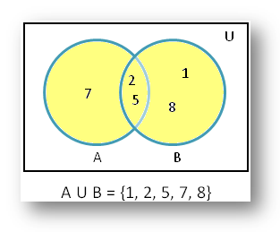
Union of Sets (Graphical Representation)

Slide 14
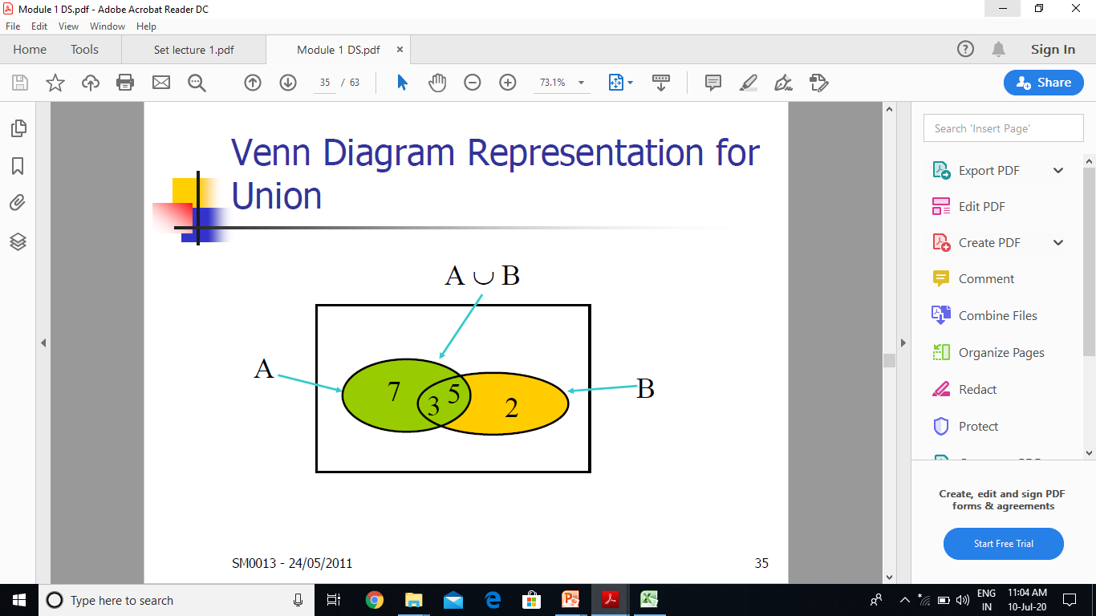

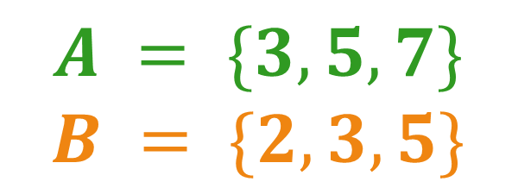
$$A = \{3, 5, 7\}$$
$$B = \{2, 3, 5\}$$
$A∪B$ = {3, 5, 7, 2}

Slide 15
Intersection of Sets
Let A and B be sets
The intersection of the sets A and B is the set containing those elements in both A and B
It is denoted by A⋂B
A⋂B = {x | x ∈ A and x ∈ B}

Slide 16
Intersection of Sets (Example)
The intersection of the sets {1, 3, 5} and {1, 2, 3}
{1, 3, 5} ⋂ {l, 2, 3} = {l,3}

Slide 17
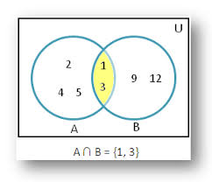
Intersection of Sets

Slide 18
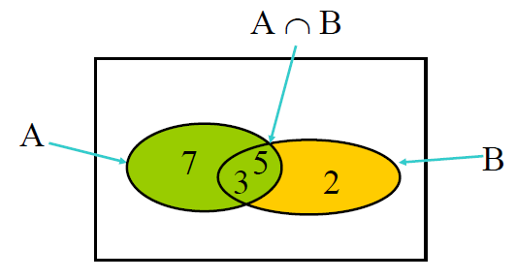

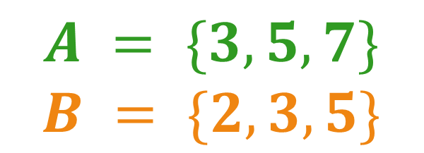
$$A = \{3, 5, 7\}$$
$$B = \{2, 3, 5\}$$
$A∩B$ = {3, 5}

Slide 19
Difference of Sets
Let A and B be two sets
The difference of A and B is the set containing those elements that are in A but not in B
It is denoted by A - B
A - B = {x | x ∈ A and x ∉ B}

Slide 20
Difference of Sets (Examples)
{1, 3, 5} - {1, 2, 3} = {5}
{ 1, 2, 3} - {1, 3, 5}= {2}

Slide 21
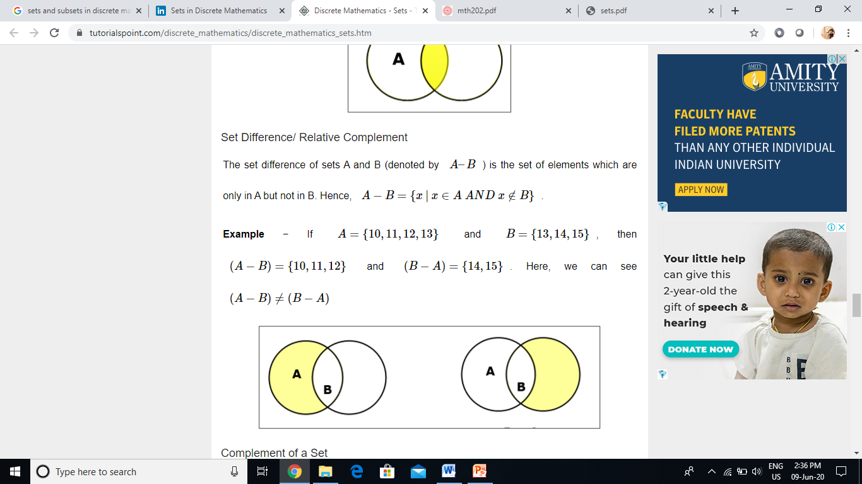
B
B
Example If A={10,11,12,13} and B={13,14,15}, then (A−B)={10,11,12} and (B−A)={14,15}.
Here, we can see (A−B)≠(B−A)

Slide 22

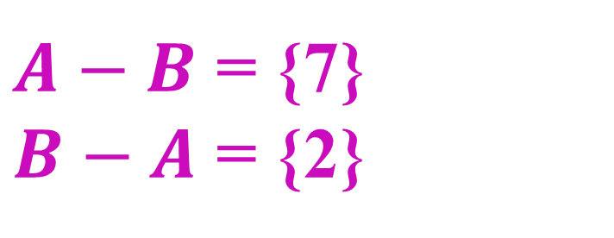
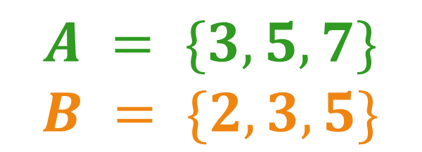
$$A = \{3, 5, 7\}$$
$$B = \{2, 3, 5\}$$
$A−B$ = {7}
$B−A$ = {2}

Slide 23
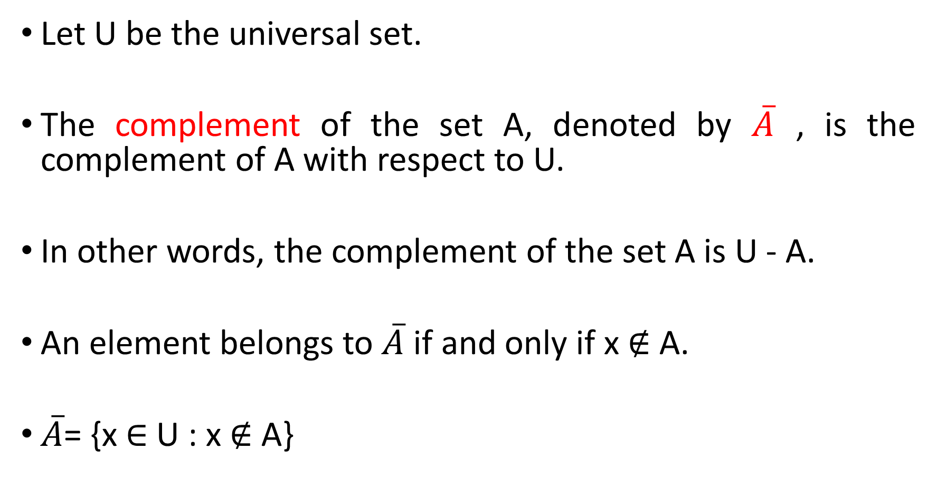
Complement of a set
Let U be the universal set.
The complement of the set A, denoted by $\overline{A}$, is the complement of A with respect to U.
In other words, the complement of the set A is U - A.
An element belongs to $\overline{A}$ if and only if x ∉ A.
$\overline{A}$= {x ∈ U : x ∉ A}

Slide 24
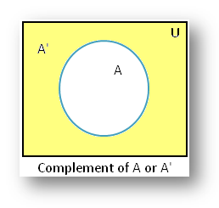
Complement of a set

Slide 25
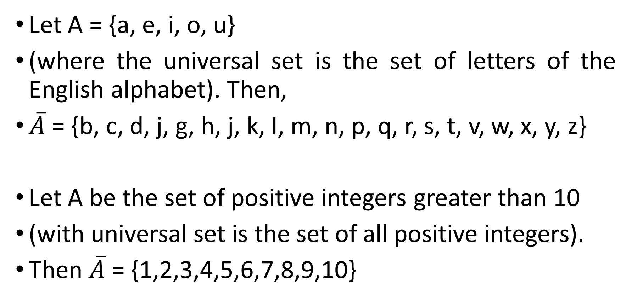
Complement of a set (Examples)
Let A = {a, e, i, o, u}
(where the universal set is the set of letters of the English alphabet). Then,
$\overline{A}$= {b, c, d, j, g, h, j, k, I, m, n, p, q, r, s, t, v, w, x, y, z}
Let A be the set of positive integers greater than 10
(with universal set is the set of all positive integers).
Then $\overline{A}$ = {1,2,3,4,5,6,7,8,9,10}

Slide 26
Disjoint Sets
Two sets A and B are called disjoint sets if they do not have even one element in common.
Two sets are called disjoint if their intersection is the empty set.
Example
Let A = {l, 3, 5, 7, 9} and B = {2, 4, 6, 8, 10}
Since, A ⋂ B = Φ, A and B are disjoint

Slide 27
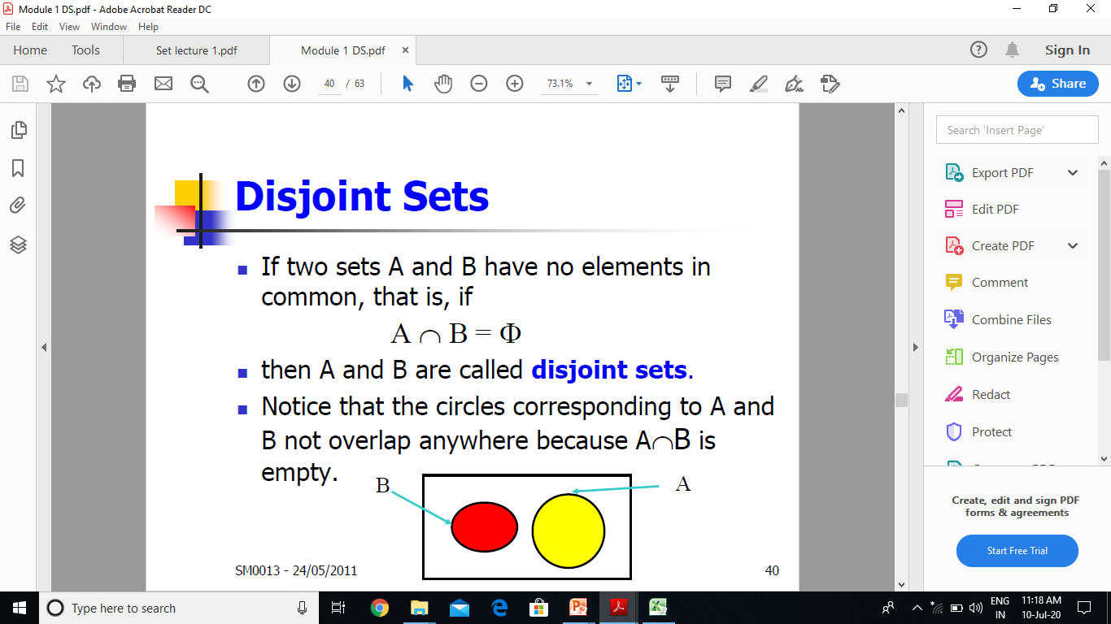
Disjoint Sets

Slide 28
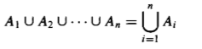
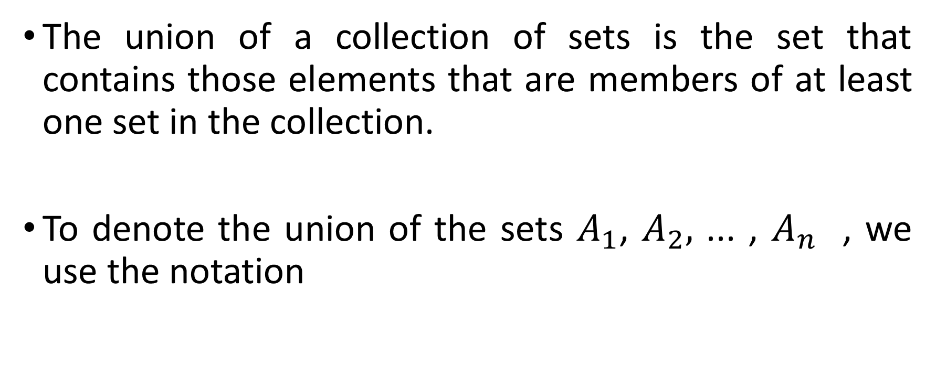
Generalized Unions
The union of a collection of sets is the set that contains those elements that are members of at least one set in the collection.
To denote the union of the sets $A_{1}$, $A_{2},$ ... , $A_{n}$ , we use the notation

Slide 29
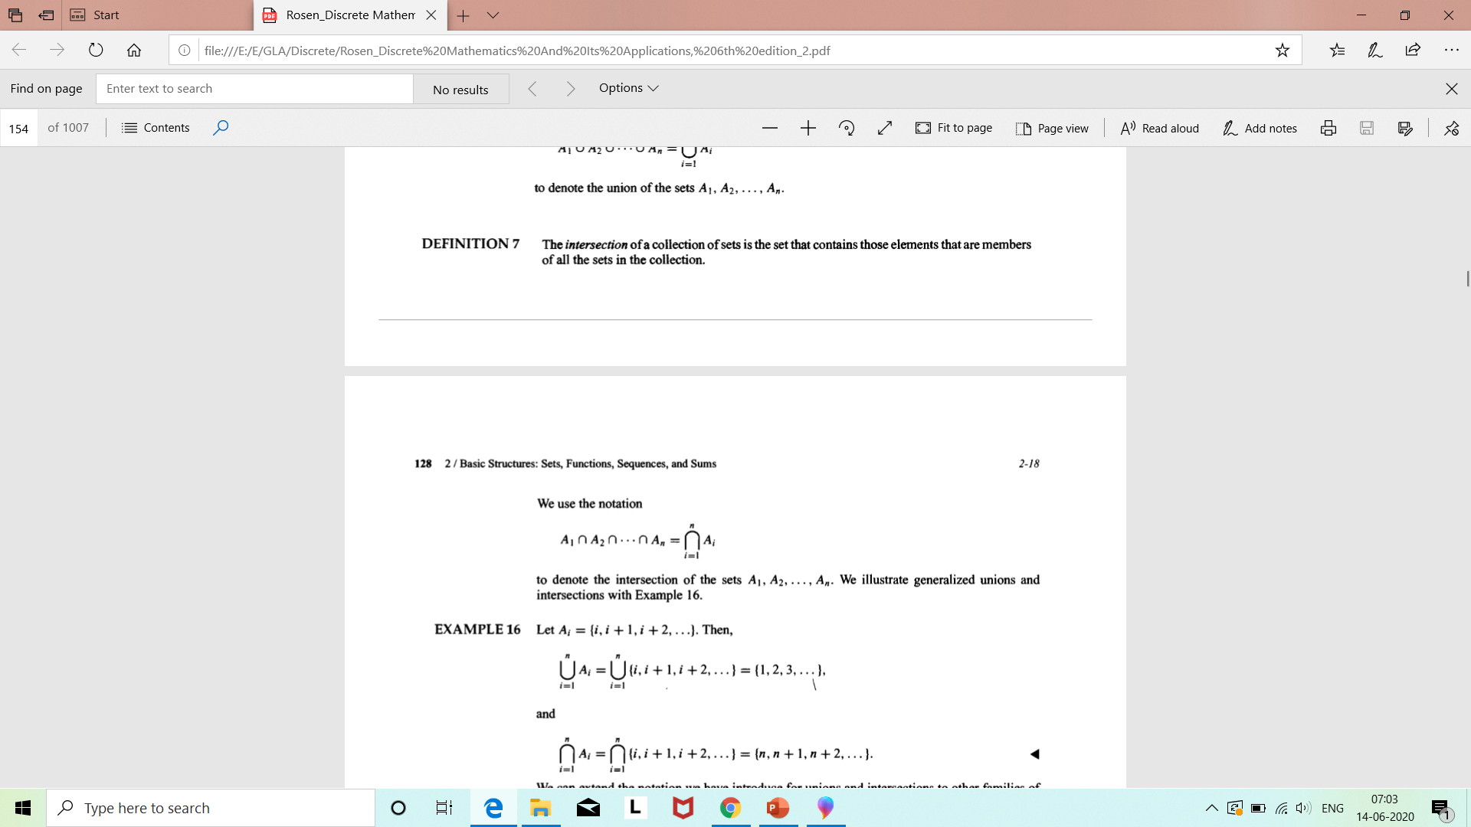
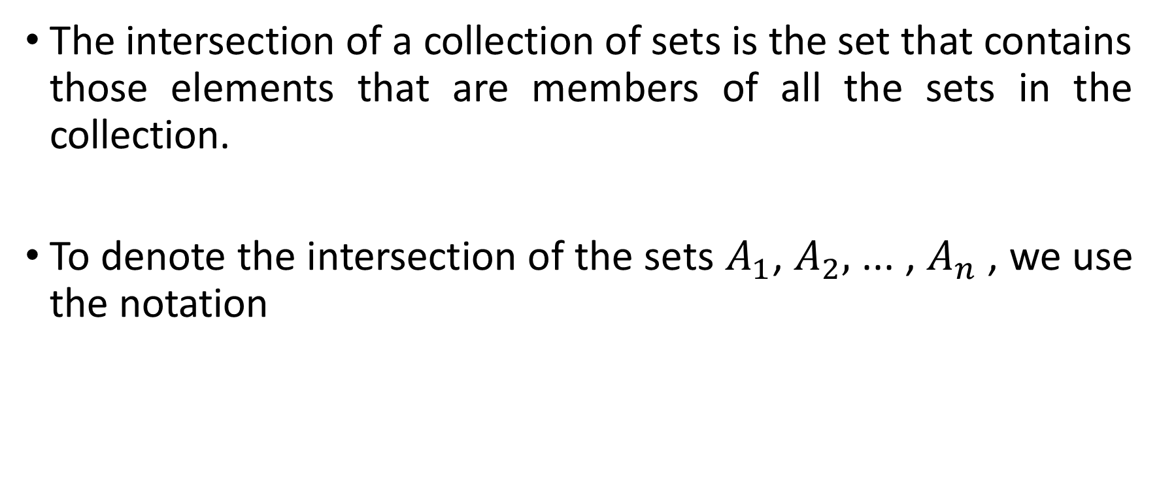
Generalized Intersections
The intersection of a collection of sets is the set that contains those elements that are members of all the sets in the collection.
To denote the intersection of the sets $A_{1}$, $A_{2},$ ... , $A_{n}$ , we use the notation

Slide 30
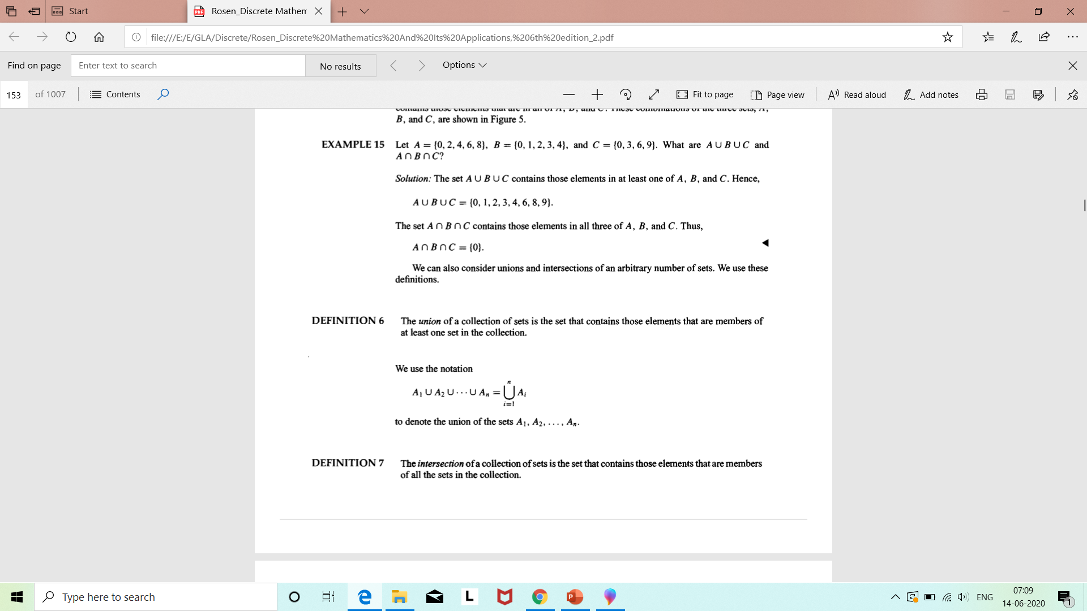
Example

Slide 31
Next Topic…
Proof Techniques

